Slide 1
ICF- Accredited Coach Training
For Mental Health Professionals
Andrew Neitlich David Brendel
Center for Executive Coaching Leading Minds Executive & Personal Coaching
www.centerforexecutivecoaching.com www.LeadingMindsExecutiveCoaching.com
941-539-9623 617-932-1548
andrewneitlich@yahoo.com david@drdavidbrendel.com

Slide 2
Agenda
Executive Coaching Defined
Why Coaching Matters
The Opportunity for Mental Health Professionals
Quick Coaching Content
Illustrative Coaching Conversations
Situational Foundations
Situational Coaching Models
Business Models
www.centerforexecutivecoaching.com

Slide 3
What Is
Executive Coaching?
Executive Coaching is an efficient, high-impact process that helps high-performing people in leadership roles improve results in ways that are sustained over time.
It is efficient because, unlike traditional consulting assignments, it does not require invasive processes, large outside teams, and lengthy reports and analyses to get results.
It is a high-impact process because Executive Coaches typically work with clients in short meetings (i.e., 30 minutes per session). During this time, the coach and client can generate important insights, gain clarity, focus, and make decisions to improve performance.
Executive Coaching works with high-performing people in leadership roles. It is not therapy, meant to “fix” a person. As an Executive Coach, your clients are already highly functioning, successful people. Like any of us, they need support from time to time in order to perform better.
Finally, your goal as an Executive Coach is to improve results in ways that are sustainable over time. Your clients want some sort of outcome, usually related to improved profits, career success, organizational effectiveness, or career and personal satisfaction. If you aren’t helping your clients get results, you aren’t doing your job. At the same time, coaching is about helping people improve their own capabilities and effectiveness, so that the results and performance improvements last. To use the time-worn and famous quote, you are teaching people to fish, not feeding them for a day.
www.centerforexecutivecoaching.com

Slide 4
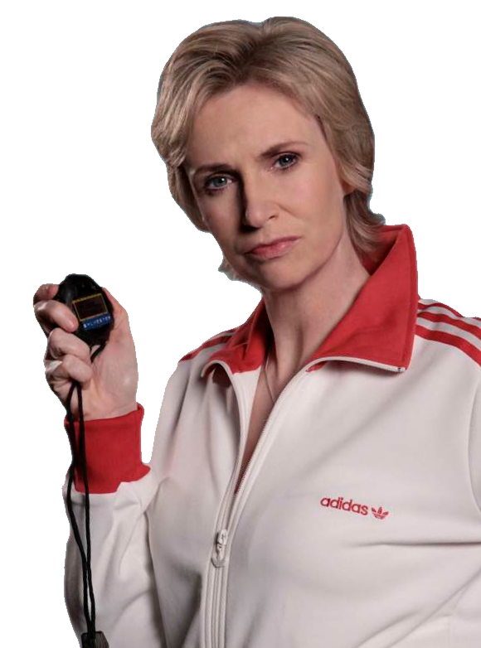
Why
Coaching
Matters
www.centerforexecutivecoaching.com

Slide 5
5
Nearly
Impossible
Executive Challenges
Do more with less…and less.
Cope with ridiculous levels of uncertainty, volatility, and blindingly rapid change.
Manage a gut-wrenching level of complexity.
Engage and mobilize people authentically
and ethically, even from great distances.
Don’t burn out!
www.centerforexecutivecoaching.com

Slide 6
CHALLENGE 1
Do more with less… and less and less
Waves of layoffs
Spans of control grow larger
Productivity improvements are often implemented poorly, while budgets are cut anyway
Perception that many companies have cut “into the bone”
Number of initiatives continues to grow
www.centerforexecutivecoaching.com

Slide 7
CHALLENGE 2
Cope with ridiculous levels of uncertainty,
volatility, and blindingly rapid change
Overnight economic shocks
Technology disruptions
Instant overseas competition
Unanticipated disasters
Corporate scandals
Incredibly fickle consumers
Sudden government intervention
www.centerforexecutivecoaching.com

Slide 8
CHALLENGE 3
Manage gut-wrenching levels of complexity
Vertical and/or horizontal layers
Multiple bosses
Global and cross-cultural mobilization
Everyone wants to be included
Uncertainty
Information overload
Changes in laws and regulatory requirements
New technologies
www.centerforexecutivecoaching.com

Slide 9
CHALLENGE 4
Engage and mobilize people
Authentically and ethically
Employees are more cynical than ever about leadership
People hide behind email, texting, and social networking
It is as hard as ever to adapt to the fact that people communicate and process information differently
A new generation of workers demands to be inspired
www.centerforexecutivecoaching.com

Slide 10
CHALLENGE 5
Don’t burn out!
Past 10 years: Doubling of the % of Americans affected by stress
53% of Americans overtired and overwhelmed by work
Among executives: 9% increase in mood stabilizing prescription drugs; 18% increase in alcohol consumption; 23% increase in divorce rate; 50% report feeling hopeless about dealing with the current challenges of leading
Trend since 2001: More executives than ever before declining promotions
www.centerforexecutivecoaching.com

Slide 11
The Presenting Problems: Short List
My people don’t do what I need them to do
The executive team is not moving in the same direction
I’m having a conflict with a colleague
The board can’t make up its mind about a strategic decision
It takes too long to get things done
We are not innovating fast enough
My boss and I are not on the same page
My career trajectory has hit a plateau
I am burning out (and so is my team)
I need to assimilate into a new culture (new country, new corporate culture)
We don’t have a strategy
We have a strategy but it isn’t getting done
Turnover is high and good people keep leaving
I need to learn some new skills (influence, more powerful communication….)
We need to turn around this organization
We have an opportunity to take things to the next level, and I don’t know how
The culture needs to change and is resisting my efforts to change it
I got feedback about a blind spot and I need help changing it
I need someone to bounce ideas around (a “sparring partner”)
www.centerforexecutivecoaching.com

Slide 12
Why Executive Coaching Is So Powerful
Unlike training and development programs, where 85% of content is forgotten in two weeks, coaching provides lasting impact and sustainable improvements
Proven process emphasizes ongoing reinforcement and measurable results, and moves forwards towards continuous improvements in performance
Content provides a set of tools and distinctions for lasting impact
Focus on data and metrics, so that our clients get accurate insights and we are all moving towards the same goals
Coaching emphasizes a holistic look at each client, including both behaviors and perceptions
www.centerforexecutivecoaching.com

Slide 13
Executive Coaching
Offers Proven ROI (when done right)
Studies consistently show an average return of between $4.30 and $7.90 for $1 invested in executive coaching.
Coaching is used as standard leadership development for elite executives and talented up-and-comers.
Training combined with coaching increases productivity by an average of 86% (VS 22%with training alone).
Fast Company: 92% of leaders being coached say they plan to use a coach again
www.centerforexecutivecoaching.com

Slide 14
And Clear
Benefits
Companies that provide coaching report these benefits (Source: ICF):
Productivity (reported by 53% of executives)
Quality
Organizational strength
Improved customer service and reduced customer complaints
Improved retention, especially among those receiving coaching
Cost reduction and bottom-line profitability (22%)
www.centerforexecutivecoaching.com

Slide 15
And Clear
Benefits
Executives who received coaching received these benefits:
Improved working relationships with direct reports (reported by 77%)
Improved working relationships with immediate supervisors
Better teamwork
Improved working relationships with peers
Greater job satisfaction (61%)
Reduction in conflicts
Improved organizational commitment
Stronger client relationships
www.centerforexecutivecoaching.com

Slide 16
Some ICF Statistics
17,000 members
10,274 credentialed coaches
2,039 more credentialed coaches than last year same time
Studies showing credentialed coaches earn more
www.centerforexecutivecoaching.com

Slide 17
More ICF Statistics
Eastern Europe: 3% of credentialed coaches
North America: 50% of credentialed coaches
Western Europe: 28% of credentialed coaches
Latin America: 3% of credentialed coaches
Oceania: 3% of credentialed coaches
Middle East and Africa: 2% of credentialed coaches
Asia: 8% of credentialed coaches
www.centerforexecutivecoaching.com

Slide 18
Many Niches
Industry (e.g. hospital executives, insurance executives)
Wide open space in that small- to mid-sized company range
Function (CFO, CIO, CMO, physician leader)
Demographic (women, baby boomers)
Psychographic (Christian business owners)
Generational (e.g., Millenials)
Situational (conflicts, influence, change leadership, succession planning for family-owned businesses, strategic planning)
Combinations of above are strongest
www.centerforexecutivecoaching.com

Slide 19
Many Openings
Assessments
Facilitation
Consulting
Retreats
Strategic Planning
Team Development
Training
Even Interim Management
www.centerforexecutivecoaching.com

Slide 20
Many Lightweights
You can succeed with some sort of edge given your training, credentials, and experience
Still too many people hanging a shingle with no skills or substance
Lots of “woo woo” style coaching
Lots of circular questioning that still causes executives to call coaching “an expensive waste of time”
www.centerforexecutivecoaching.com

Slide 21
So Long As You
Have solid tools, methods, and frameworks
Track progress start to finish
Develop some core competencies to meet standards
Are comfortable being in two businesses – coaching and business development
www.centerforexecutivecoaching.com

Slide 22
The
Opportunity
For Mental Health Professionals
www.centerforexecutivecoaching.com

Slide 23
ar
Mental Health Professionals Are Poised for Success as Professional Coaches…
…but they need good training to build and succeed in a coaching practice
www.centerforexecutivecoaching.com

Slide 24
Qualities of Mental Health Professionals Critical for Coaching
Ability to ask powerful, open-ended questions
Non-judgmental attitude
Excellent listening skills
Understanding of human psychology
Tolerance of emotional distress and complex interpersonal situations
Respect for clients as agents who can gain insight and solve their own problems
Capacity to motivate clients to make important life changes and enhance quality of life
www.centerforexecutivecoaching.com

Slide 25
6 Obstacles to Success for Mental Health Professionals Becoming Coaches
1) Need to avoid “diagnosing” or pathologizing
2) Focus must be on strengths and “positive psychology”
3) Learning curve regarding the language and customs of the business world
4) Must feel confident and stand “shoulder to shoulder” with CEOs
5) Selling coaching services is different than receiving patient referrals
6) Billing for services is different in coaching practice
www.centerforexecutivecoaching.com

Slide 26
Solid Training and ICF-Certification Yield Success
All coaches must develop core competencies of practice
ICF is the current standard bearer for quality in the field
Mental health professionals have additional opportunities and needs
Coach certification combined with mental health experience can set you apart
How best to obtain coach training and experience tailored to your particular background and needs?
www.centerforexecutivecoaching.com

Slide 27
Training Program:
Joint Offering of the CEC and
Leading Minds Executive & Personal Coaching
Didactic materials and books
Tele-calls
Individual mentoring sessions
Review and feedback of recorded coaching sessions
Opportunity to attend group seminars for further training and networking
ICF mentor coaching
CEC certification
Fast track opportunity for ICF certification
www.centerforexecutivecoaching.com

Slide 28
Quick Coach Content
www.centerforexecutivecoaching.com

Slide 29
The Seven
Orientations
Relationships
Outcomes
Possibility
Stand for the client’s commitments and aspirations
Equal footing
Dialogue
Build capacity
www.centerforexecutivecoaching.com

Slide 30
The Three
Domains
Content: What
Process: How
Context: Ways of Being
GREAT coaching almost always includes conversations about context: the client’s attitudes, behaviors, and ways of relating with others.
www.centerforexecutivecoaching.com

Slide 31
The Three Levels Of Coaching
Level I: Ask powerful, open-ended questions in the hopes that the client will have insights (active inquiry)
Level II: Bring high-impact frameworks to focus on specific situations
Level III: Become a thought leader by developing your own frameworks
www.centerforexecutivecoaching.com

Slide 32
The Three Levels Of Coaching
The Executive Coaching Process
Set Goals
Point A – Point B
Agree on Approach
4
Coachable?
Problem?
Permission?
Coach,
Track,
Adjust,
Succeed
Assess, Diagnose, Design
Agree on Scope/
Boundaries
1
3
5
2
Coaching Foundation
Follow Up
Celebrate
8
6
Next Situation/Goal
7
www.centerforexecutivecoaching.com

Slide 33
Typical Agenda
Over Time
Core Agenda
In Parallel
Set scope, boundaries, objectives
Weekly sessions:
The overall coaching topic(s)
Coaching about current issues
Introduce topics via a curriculum as appropriate
Continue weekly sessions if client has ongoing issues; or shift to monthly, then quarterly sessions if client is on “maintenance”
Conduct assessment, as appropriate (which can be a value-add service in exchange for 6 month or longer contract)
Perhaps identify opportunity to work with executive team, lead retreat, conduct training, consult….
(As appropriate): Conduct assessments every 6-12 months to confirm progress and identify new issues; keep client moving forward
www.centerforexecutivecoaching.com

Slide 34
A Few Illustrative
Executive Coaching
Conversations
www.centerforexecutivecoaching.com

Slide 35
Key Coaching Conversations
Active Inquiry
Appreciative Inquiry
Listen/Confirm Understanding/Reflect
Accountability
Acknowledge
Share Stories
Move the Conversation Forward
Set Context
Introduce a Framework, Tool, Exercise, or Distinction
Establish/Re-establish Coachability
www.centerforexecutivecoaching.com

Slide 36
1. Active inquiry
Introduce what you will do
For 10-20 minutes, I’ll ask you open-ended questions. The goal is to have you come up with some insights about the issue and how to resolve it. Then I’ll ask you what insights you had, ask permission to share any insights I might have, and we can go from there.
Ask open ended questions with the goal of having the client generate insights
What, where, when, how, who and (carefully) why
Be sure to listen actively and confirm understanding
Go for high-voltage questions that have some “juice”
Ask the client to summarize one or more insights he had, and what he will do about them
Ask permission to share your own insight
www.centerforexecutivecoaching.com

Slide 37
2. Appreciative inquiry
A subset of active inquiry in which you focus on what is working, on the positive, and on building on strengths and success
Examples:
What’s working that you can build on?
What strengths can you bring to bear on this?
What resources do you have?
What are some small wins you can get?
What’s possible?
www.centerforexecutivecoaching.com

Slide 38
3. Listen/Confirm Understanding/Reflect
Basic: Confirm intellectual understanding
Advanced: Reflect back the emotions
“This must be frustrating for you…”
“If I were in your shoes, I’d be excited, too”
Advanced: Listening for something
Commitment
Blind spot
Accountability
Coachability
Opportunity to use a coaching tool
Etc.
www.centerforexecutivecoaching.com

Slide 39
4. Accountability
Call them on their behavior when they don’t do what they said they would do
Question their commitment
Is this really important to you?
Take time during the coaching session to get the work done
Go below the surface to explore limiting perceptions or other obstacles keeping them from taking their word
www.centerforexecutivecoaching.com

Slide 40
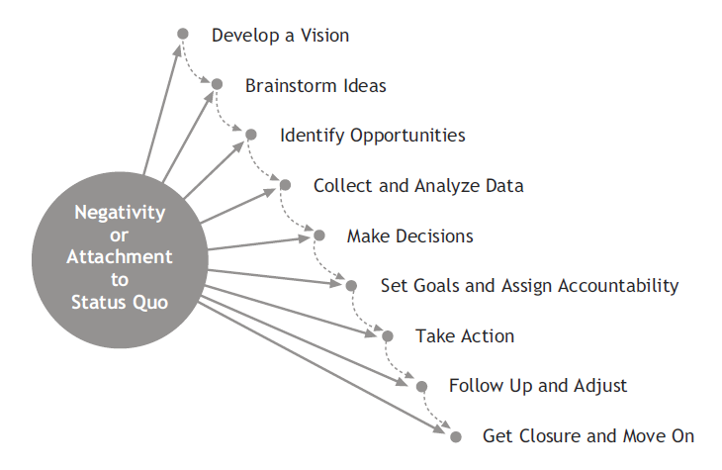
5. Move the conversation
forward
Most people are stuck in apathy, resignation, cynicism, the status quo or complaint
The coach shifts people from there to any of the following:
Possibility/Vision
Opportunities/Ideas
Analyzing alternatives
Making a decision about which alternative
to pursue
Setting goals and accountability
Taking action
Following up and adjusting
Getting closure and moving on
www.centerforexecutivecoaching.com

Slide 41
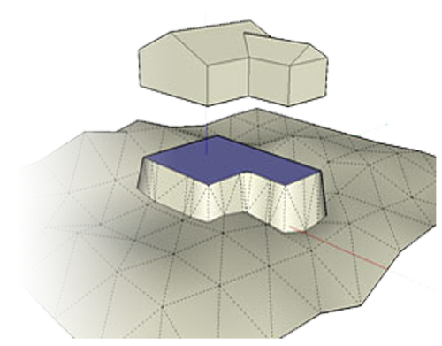
Situational Foundations:
Behavioral And Perceptual Coaching
www.centerforexecutivecoaching.com

Slide 42
Behavioral
Coaching
Can address a behavioral blind spot that is derailing the client’s career, or be an excellent way to pick one thing to be better while improving the culture
Choose one behavior that is simple, relevant, and easy to measure (smiling, making eye contact, acknowledging employees, letting people finish their sentence without interrupting).
Build a support structure to make the new behavior a habit, including: feedback, tracking progress, notes, affirmations, stress reduction tactics, pre-planning, AAA, and other tools from applied cognitive behavioral research
www.centerforexecutivecoaching.com

Slide 43
Perceptual
Coaching
Identify and reframe a limiting belief, and the new perception and associated behaviors habitual
Examples:
I can’t trust my people
Conflict is bad
I need to be the hero
Everything needs to be perfect
I would rather be “X” than successful
www.centerforexecutivecoaching.com

Slide 44
Situational Coaching Frameworks
Personal domains
Strategic planning
Executive dashboard
Engage and mobilize employees
Manage time
Conflict resolution
Communicate simply and powerfully
Power base strategy
Change management
Influence skills/politics of idea acceptance
Create a high-performance culture
Success planning
Thinking comprehensively and systematically about issues
Performance improvement
Career transition/First 90 days
www.centerforexecutivecoaching.com

Slide 45
Business
Models
www.centerforexecutivecoaching.com

Slide 46
Time For Dollars
To Firm Builder
1-2 Days: Marketing
1 Day: Writing/Product Development
2-3 Days: Coaching
2 Days = 12 client sessions
12 clients X $X per month (priced by engagement)
3 Days = 18 client sessions
More than 3 Days: Add a coach, and then another, and another. Take 33% as a marketing fee. Many coaches can’t market, and will happily work 4-5 days per week for you. Create passive income. Build leverage...
www.centerforexecutivecoaching.com

Slide 47
Leverage through people and/or products
Program 5
Price
Program 4
Program 3
Program 2
Program 1
Market Size
Goal: Offer programs and services for clients at every price point. Maximize leverage and passive income.
www.centerforexecutivecoaching.com

Slide 48
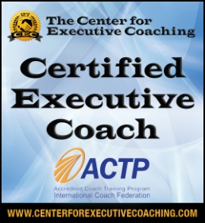
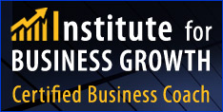
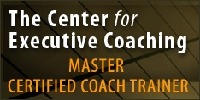
Example
Leverage Through Products And People
Solo Solutions
(Time For Dollars)
Emerging Growth/Entrepreneurs
Professional Services Firms
Non-Profits/Board Retreats
Healthcare
Universities
One-on-one coaching
Group coaching
Leadership training
Strategic retreats
Public speaking gigs
Never by the hour; Always by
value & always priced as engagement for a solution
Alliances:
Franchise Success Institute
Physician Transition Institute
Institute for Technology Leaders
www.centerforexecutivecoaching.com

Slide 49
ICF- Accredited Coach Training
For Mental Health Professionals
Andrew Neitlich David Brendel
Center for Executive Coaching Leading Minds Executive & Personal Coaching
www.centerforexecutivecoaching.com www.LeadingMindsExecutiveCoaching.com
941-539-9623 617-932-1548
andrewneitlich@yahoo.com david@drdavidbrendel.com

